Slide 1
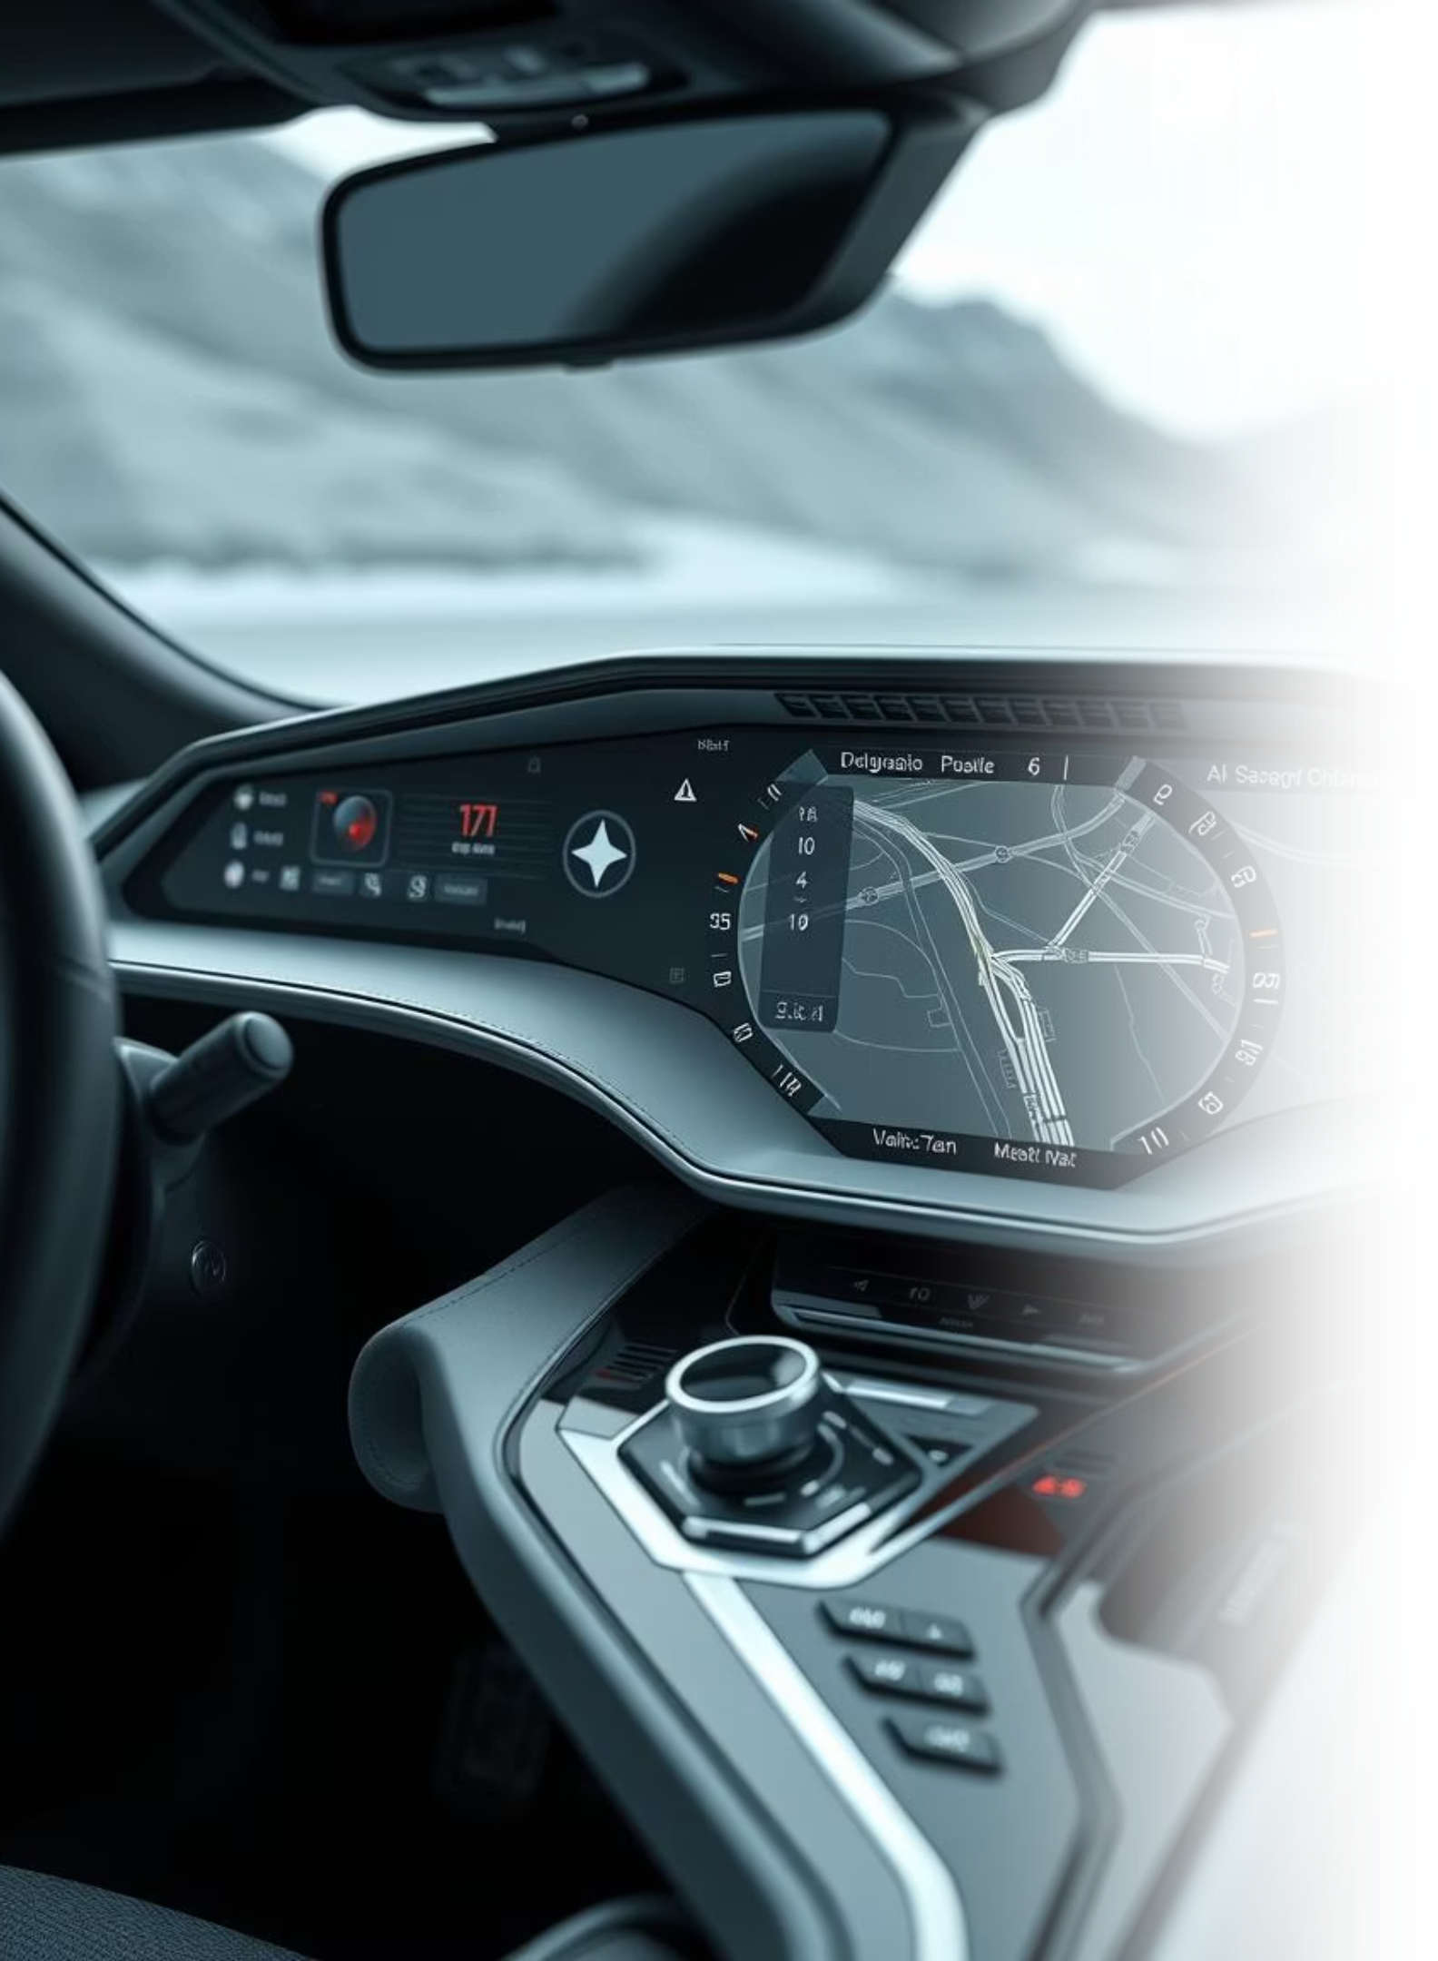
Smart Vehicle Diagnostics and SMS-Based Location Tracking System
Presented by: Pinniti Lokesh
Poka Venkata Sai Jayanth
Palakonda Venkata Sai Teja
Guided by: Sarath V P

Slide 2



Project Overview
monitors real-time vehicle parameters like RPM, speed, temperature, fuel level, and detects accidents using sensors, transmitting data via the CAN bus.It integrates GPS and GSM modules to send live location and alerts through SMS, enabling remote monitoring and motor control.
Real-time Diagnostics
Location Tracking
SMS Alerts & Control
CAN bus data for RPM, speed, temperature, and fuel.
GPS-based tracking with accident/flip detection.
Automated alerts and remote motor ON/OFF via GSM.

Slide 3
Addressing Critical Vehicle Challenges
Modern vehicles, despite their advancements, often lack integrated solutions for critical real-time monitoring
and emergency response. Our system directly tackles these prevalent issues:
The Problem:
Our Solution:
Absence of real-time remote diagnostics
(RPM, speed, engine temperature, fuel).
Robust and cost-effective embedded solution for vehicle
monitoring.
Combines comprehensive diagnostics including RPM, speed,
temperature, and fuel level tracking.
Provides precise location tracking using GPS technology.
Enables essential remote control capabilities such as motor
start/stop via SMS.
Fills significant gaps in current vehicle systems by
integrating safety alerts and accident detection.
No remote control mechanisms for theft or breakdown scenarios.
Lack of immediate, automatic accident alert systems.
Limited affordable, integrated GPS and CAN bus solutions.

Slide 4
System Architecture: Key Components
Our system is built upon a carefully selected array of microcontrollers, sensors, and communication modules,
each playing a vital role in the system's functionality:
Microcontrollers:
Actuators & Others:
ESP32: Utilised as both the Receiver Node and Transmitter Node,
leveraging its powerful dual-core processing capabilities.
JGB37 -520 - 12V - 100RDC Motor + L298N Motor Driver: Simulates
vehicle movement for testing.
Sensors & Modules:
Push Button: For convenient mode switching
(GPS or CAN diagnostics).
NEO-6M GPS Module: For accurate location tracking.
Analog Accelerometer (X, Y, Z): Critical for accident and vehicle
flip detection.
12 Battery, Power Supply & Wires: Essential for system operation.
Temperature Sensor: Monitors engine temperature.
Fuel Level Sensor: Provides real-time fuel percentage data
Rotary Encoder: Measures Revolutions Per Minute (RPM).
SIM900A GSM Module: Enables SMS alerts and
command reception.
MCP2515 CAN Bus Module: Facilitates robust CAN communication
between nodes.

Slide 5
Dual-Node Operational Diagram
Our system is intelligently segregated into two primary ESP32-based nodes, each with distinct responsibilities, communicating seamlessly via CAN bus for optimal performance and modularity.
Receiver Node
Transmitter Node
Integrated with ESP32, GPS, Accelerometer, GSM, and CAN Receiver.
Comprises ESP32, DC Motor (simulation), Rotary Encoder, Temperature Sensor, Fuel Level Sensor, and CAN Transmitter, Which acts as a OBD-2 port.
Reads GPS and accelerometer data for real-time location and flip detection.
Actively measures RPM, simulated speed, engine temperature, and fuel level.
Processes incoming CAN data for vehicle diagnostics.
Initiates SMS alerts for accidents and responds to user SMS commands.
Transmits all collected diagnostic data over the CAN bus to the Receiver Node.
Features a physical button to toggle between GPS mode and CAN diagnostics mode.

Slide 6





Why ESP32? The Powerhouse Behind Our System
The ESP32 microcontroller was chosen as the core of our system due to its unparalleled versatility and robust features, making it ideal for managing multiple concurrent tasks in an embedded environment.
Dual-Core Processor
Rich Connectivity
High Processing Speed
Efficiently handles concurrent tasks such as GPS data processing, GSM communication, and CAN bus operations without performance bottlenecks.
Multiple UART, SPI, and I2C interfaces provide seamless integration with a wide array of sensors and modules, including GSM, GPS, and CAN.
Delivers rapid data acquisition and processing at a remarkably low cost, ensuring real-time responsiveness for critical vehicle diagnostics.
Future-Proofing
Ample GPIO Pins
Built-in Wi-Fi and Bluetooth capabilities allow for effortless future upgrades, such as cloud integration or mobile app connectivity.
Sufficient General Purpose Input/Output pins facilitate easy connection and control of various sensors, CAN module, GSM module, and user interface components.

Slide 7
System Flow: How It Works
Our system operates through a structured sequence of processes, ensuring efficient data flow and responsive command execution.
01
02
03
System Initialization
Transmitter Node Operations
Receiver Node Operations
Both ESP32 nodes power up and initialise all connected modules, including GPS, GSM, CAN, and various sensors, establishing a ready state for operation.
Continuously reads RPM from the rotary encoder, calculates speed, and measures engine temperature and fuel level from analog sensors.
Receives and updates vehicle diagnostic data from the Transmitter Node via CAN bus.
Continuously reads GPS coordinates and accelerometer values.
Transmits all collected diagnostic data via the CAN bus (ID 0x100) at one-second intervals.
Triggers an immediate SMS alert with precise vehicle location to predefined emergency numbers if an accident (e.g., vehicle flip) is detected.
Actively monitors the CAN bus for incoming motor control commands (ID 0x101) from the Receiver Node.
Responds to specific SMS commands from the user
A dedicated push button allows the user to toggle the Receiver Node's primary response mode between GPS location reporting and CAN diagnostics.

Slide 8
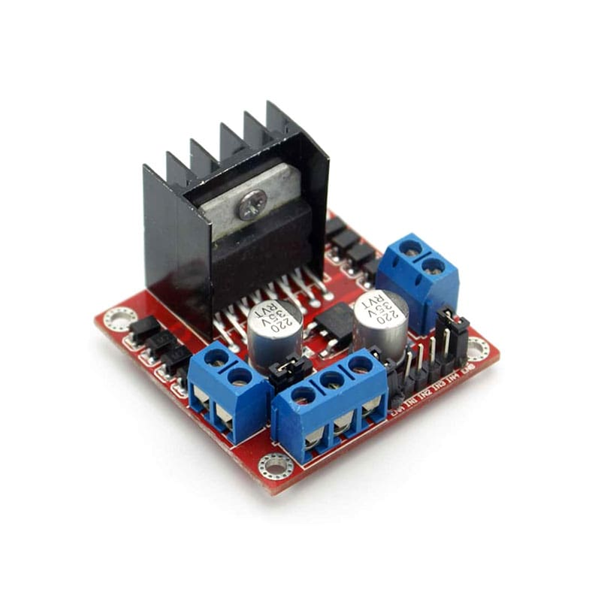
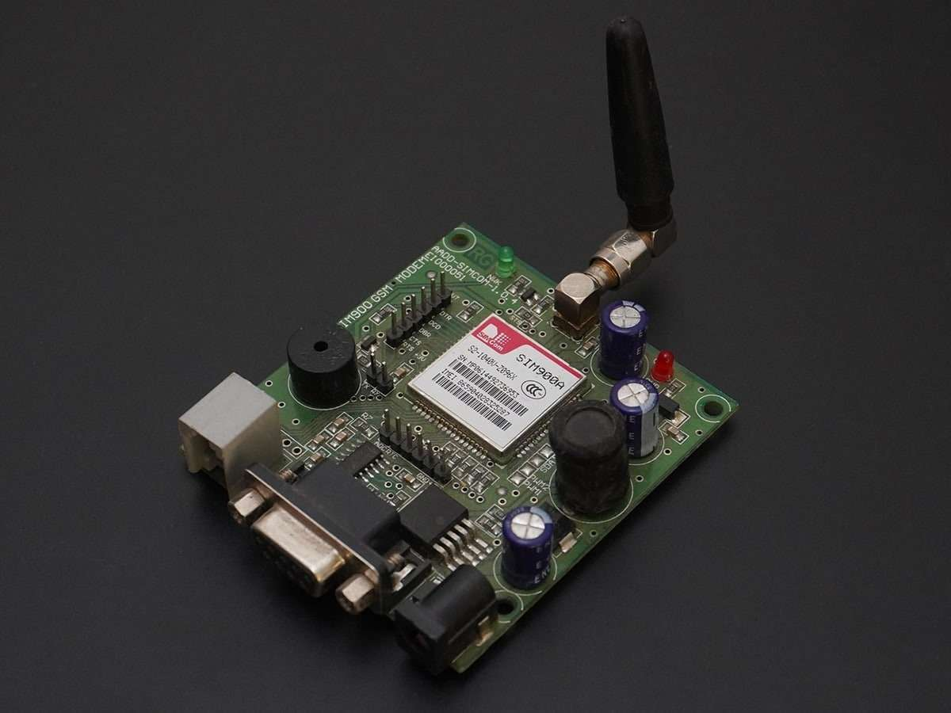
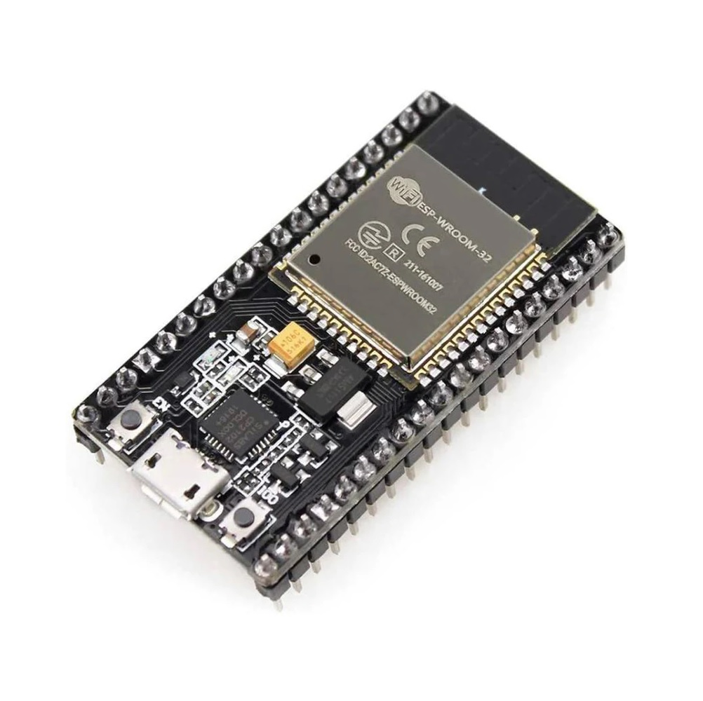
Components Used :
L298N Motor Driver
SIM 900 A
ESP 32 Micro Controller

Slide 9
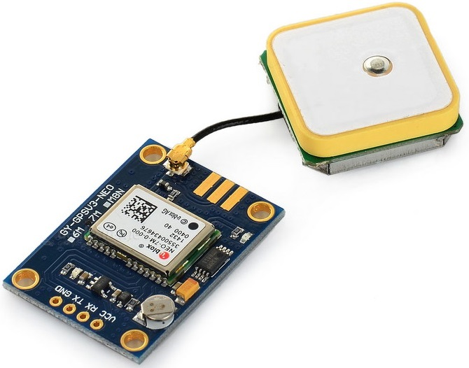
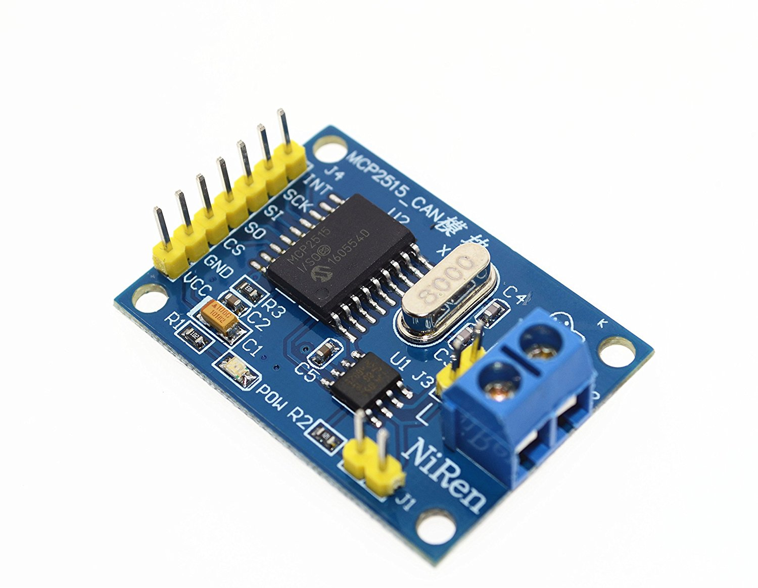
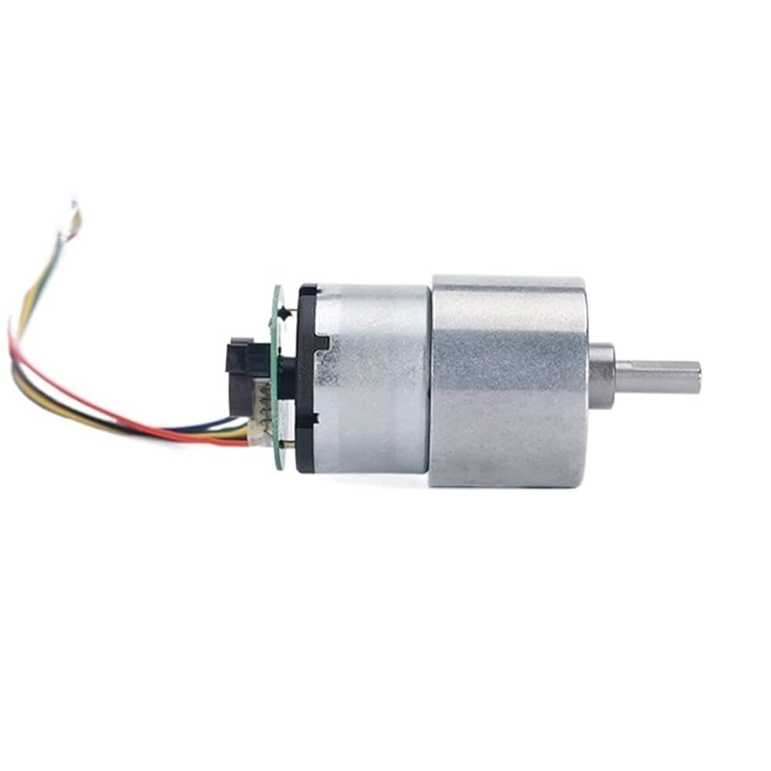
NEO 6M GPS Module
MCP 2515 CAN BUS Module
JGB37-520 DC Motor (12V, 100 R)

Slide 10
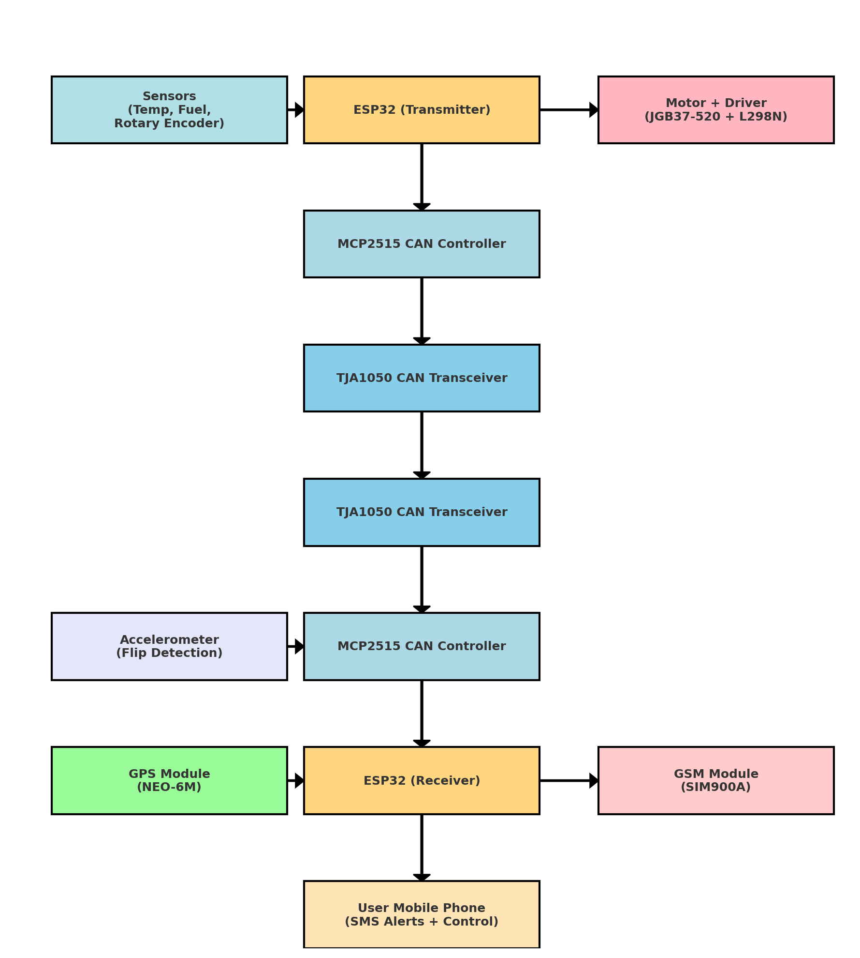
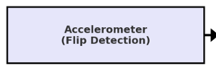
Flow Diagram :

Slide 11
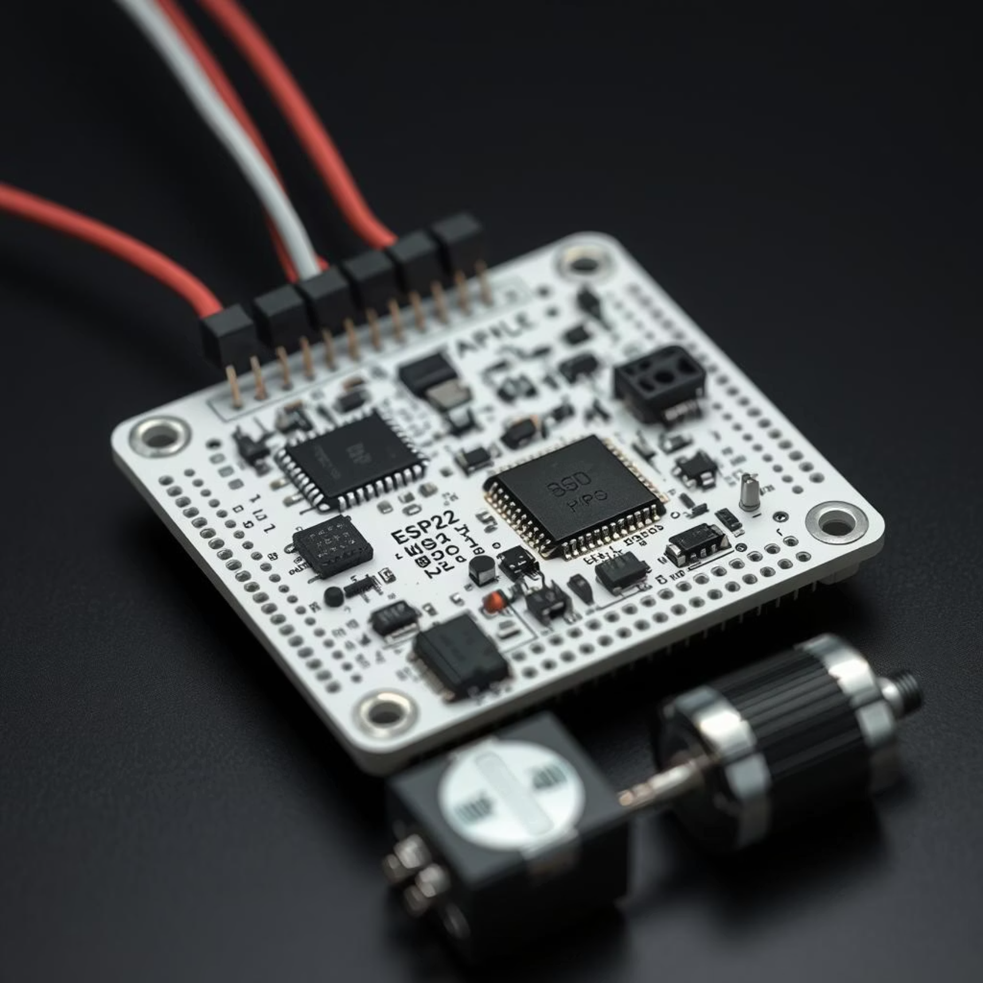
The Prototype: Bringing the Concept to Life
Our prototype demonstrates the practical implementation of our system, showcasing the seamless integration and functionality of each component in a controlled environment.
Key Prototype Elements:
Two-Node ESP32 Setup: Demonstrates robust CAN communication between distinct microcontrollers.
DC Motor + Encoder: Accurately simulates vehicle speed and RPM data for diagnostic testing.
Temperature and Fuel Sensors: Provides live diagnostic readings, mirroring real-world vehicle parameters.
GPS Module: Enables real-time location tracking, verifying positional accuracy.
Accelerometer: Validates accident and flip detection capabilities through simulated events.
GSM Module: Confirms reliable SMS communication for alerts and remote commands.
This prototype serves as a tangible proof-of-concept, validating the system's design and functionality.

Slide 12

Real-World Applications
The versatile capabilities of our system extend across various sectors, promising significant benefits and operational efficiencies.
Fleet Management
Emergency Response
Real-time vehicle diagnostics for preventative maintenance.
Automatic and precise accident reporting drastically reduces emergency response times.
Optimised routing and operational efficiency with continuous location tracking.
Provides exact location data for rapid deployment of rescue services.
Enhanced safety for commercial fleets through immediate accident alerts.
Theft Prevention & Recovery
Remote vehicle shutdown capability acts as a strong deterrent against theft.
Continuous location tracking aids in swift recovery of stolen vehicles.
Immediate alerts upon unauthorised movement or tampering.

Slide 13
Conclusion: A Holistic Solution for Modern Vehicles
The Smart Vehicle Diagnostics and SMS-Based Location Tracking System offers an innovative and practical answer to pressing needs in vehicle safety, monitoring, and control.
Enhanced Diagnostics
Critical Safety Features
Provides precise, real-time vehicle diagnostics via CAN bus, offering immediate insights into vehicle health.
Automated accident/flip alerts with GPS location ensure rapid emergency response and increased occupant safety.
Remote Control & Security
Cost-Effective & Scalable
Enables remote motor control via SMS, adding a vital layer of security and convenience.
A low-cost, integrated solution with inherent scalability for future enhancements and broader applications.

Slide 14
CHALLEGES FACED
Power supply issues When integrating with the SIM 900A Module
CAN Bus Communication Issues
Initial difficulty in synchronizing transmitter and receiver. Proper selection of CAN IDs and baud rate to avoid message collisions.
SavvyCAN Integration.

